Slide 1



NETFLIX
WWW.NETFLIX.COM
PRESENTED BY
KIRUBAKARAN V
01

Slide 2


WHAT ?
A COLLECTION OF METADATA ABOUT THE TITLES AVAILABLE ON NETFLIX (BOTH MOVIES AND TV SHOWS)
WHAT WE ANALYZE?
MOIVES VS TV SHOWS (DISTRIBUTION & GROWTH)
POPULAR GENRES, RATINGS, AND COUNTRIES
CONTENT AGE, RELEASE TRENDS, AND DURATION
STATISTICAL TESTS TO COMPARE GROUPS
02

Slide 3

INTRODUCTION
Total Records
~8,800 titles (Movies + TV Shows)
Key Features
Type (Movie or TV Show), Title, Director, Cast, Country
Date Added, Release Year, Rating, Duration
Listed_in (Genres), Description
Derived Metrics
Year Added & Month Added (to study trends)
Content Age (gap between release year and Netflix addition)
Duration_num (minutes for Movies, seasons for TV Shows)
Number of Shows (count of genres per title)
03

Slide 4
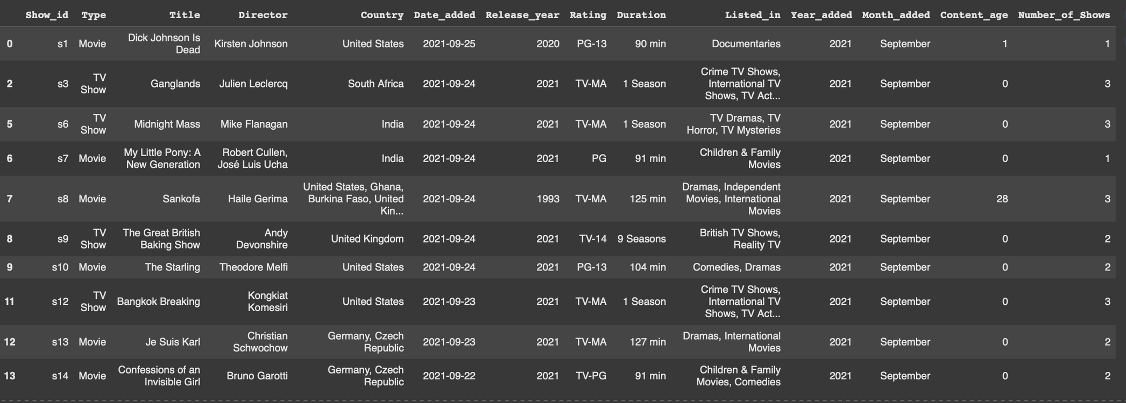
DATASET OVERVIEW
04

Slide 5


DATA CLEANING
MISSING VALUES
HANDLING INCONSISTENT VALUES
OUTLIER DETECTION & TREATMENT
Filled Country using forward fill (ffill).
Filled Date_added and Rating using mode.
Replaced missing durations with mode values (e.g., “90 min” for Movies)
Standardized Country names and Genres.
Converted Date_added to proper datetime format.
Dropped duplicates and incomplete rows.
Removed illogical values (future Release_years).
Ensured Duration correctly separated → minutes for Movies, seasons for TV Shows.
Focused analysis on valid records with realistic values.
05

Slide 6
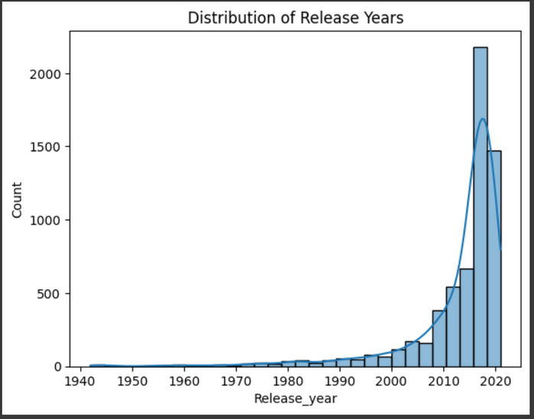
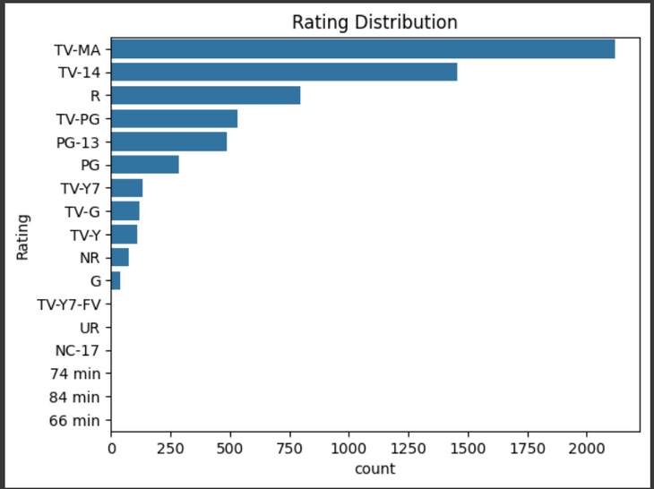
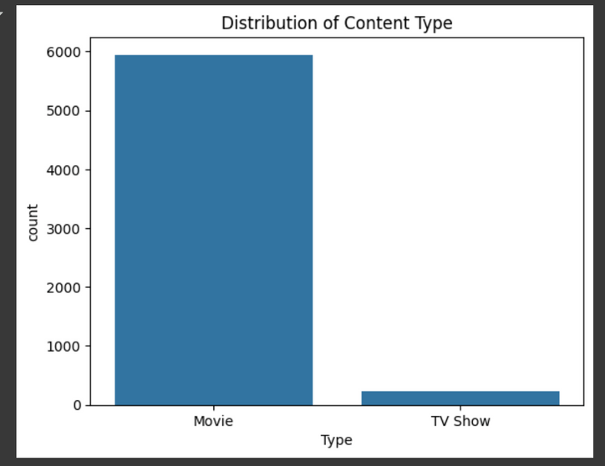
EXPLORATORY DATA ANALYSIS
UNIVARIATE ANALYSIS
histogram plot for Release year
Count plot for Rating
Count Plot for Content type
06

Slide 7
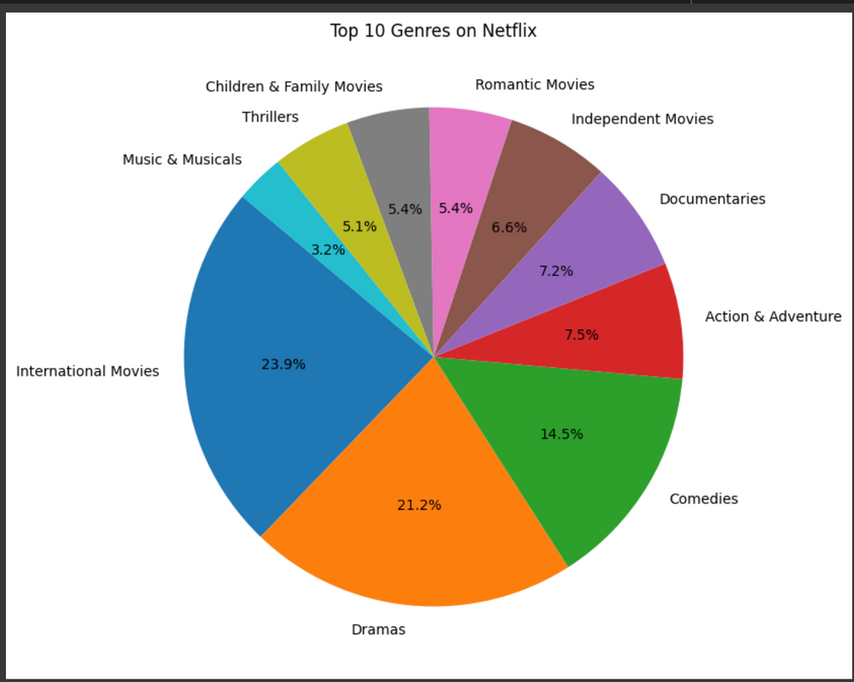
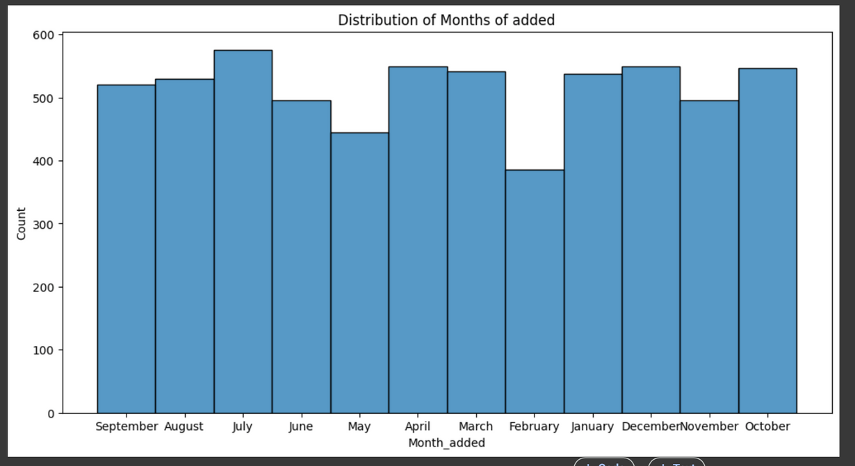
Histogram Plot for Months of added
Pie Chart for Geners
07

Slide 8
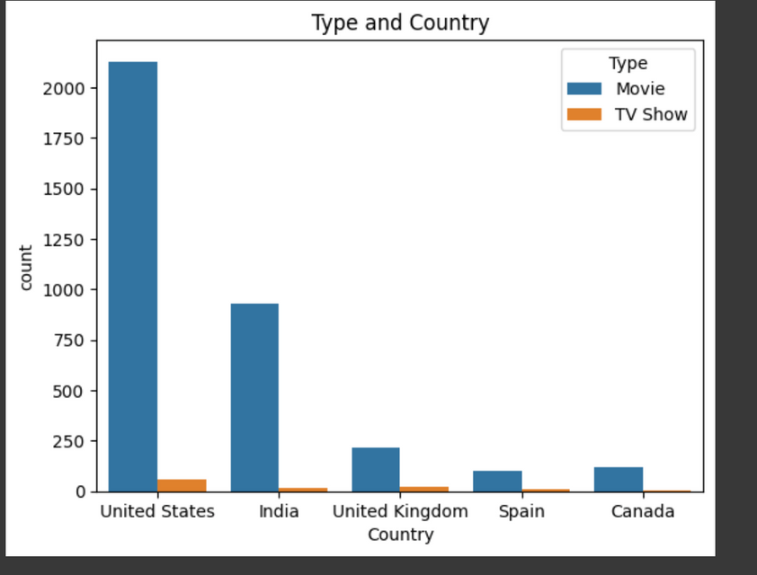
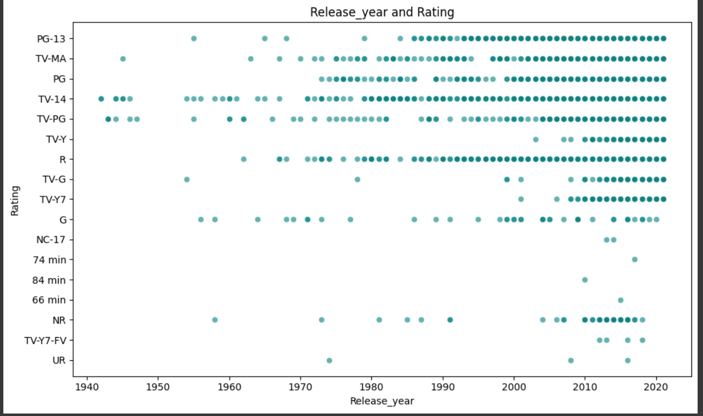
BIVARIATE ANALYSIS
08
Scatterplot
for Release year and Rating
Countplot
for Type and Country

Slide 9
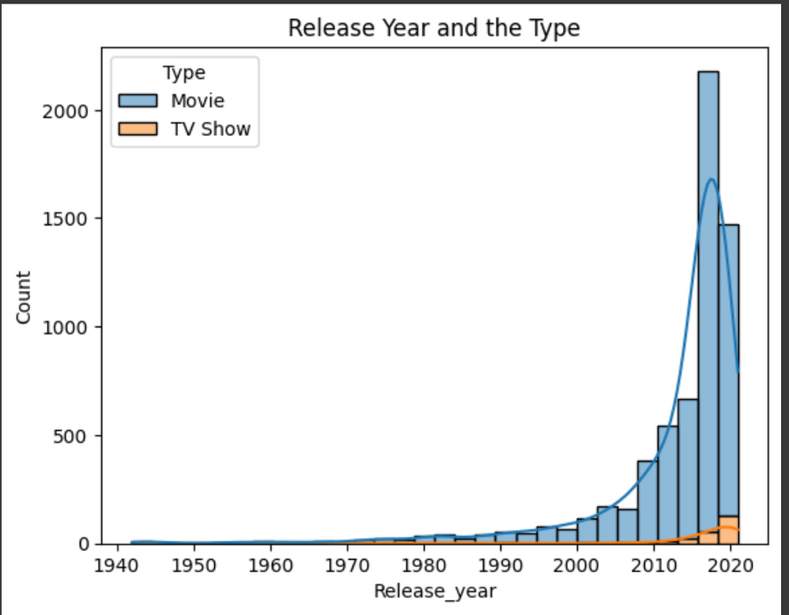
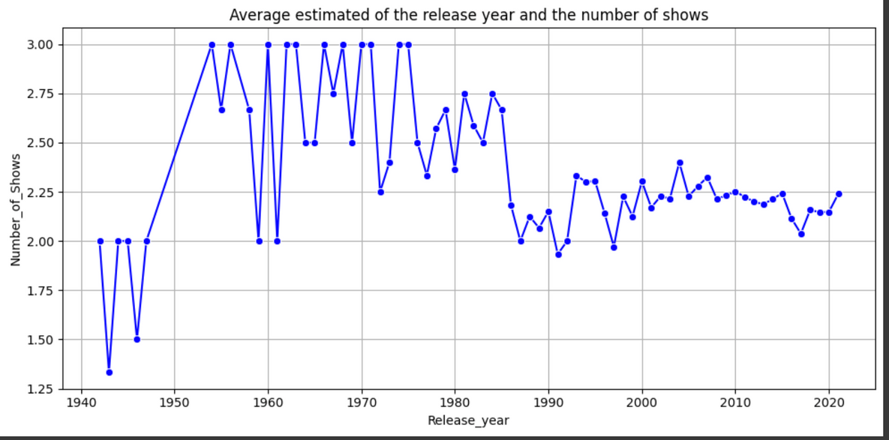
Line plot
for Release year and No of Shows
Count plot
for Release year and Type
09

Slide 10
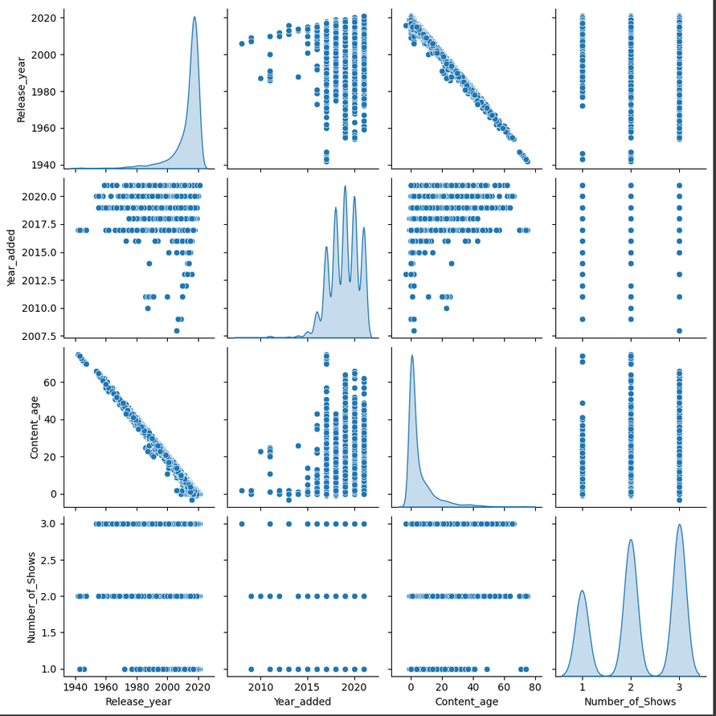
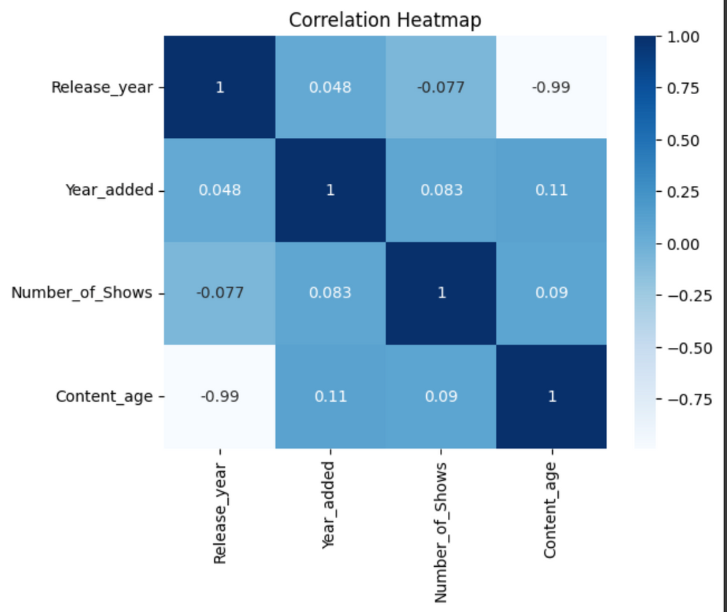
MULTIVARIATE ANALYSIS
10
HEATMAP
PAIRPLOT

Slide 11
THANK YOU
- KIRUBAKARAN V
11

